Slide 1
Hotel Reservation Analysis with SQL
Presented By Smriti Keshri for Mentorness
Under Batch MIP-DA-10

Slide 2
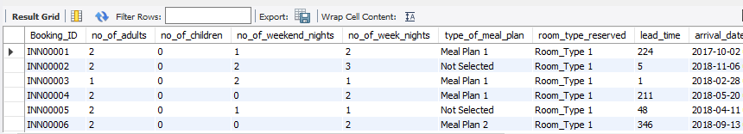
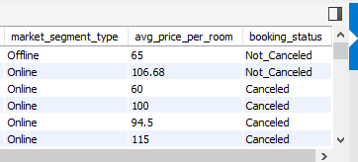
Dataset:

Slide 3
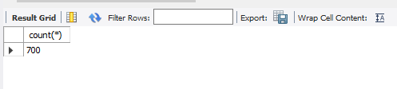
1. What is the total number of reservations in the dataset?
SELECT count(*) FROM 2ndproject.`hotel reservation dataset`;

Slide 4

2. Which meal plan is the most popular among guests?
SELECT type_of_meal_plan, count(type_of_meal_plan)
AS meal_plan_count FROM 2ndproject.`hotel reservation dataset`
GROUP BY type_of_meal_plan
LIMIT 1;

Slide 5

3. What is the average price per room for reservations involving children?
SELECT avg(avg_price_per_room) From 2ndproject.`hotel reservation dataset` where no_of_children!=0;

Slide 6
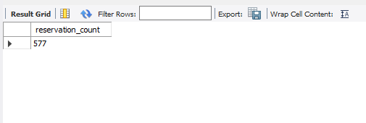
4. How many reservations were made for the year 20XX (replace XX with the desired year)?
SELECT count(*) AS reservation_count FROM 2ndproject.`hotel reservation dataset` WHERE year(arrival_date)=2018;

Slide 7
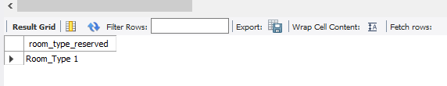
5. What is the most commonly booked room type?
SELECT room_type_reserved FROM 2ndproject.`hotel reservation dataset` GROUP BY room_type_reserved ORDER BY count(room_type_reserved) DESC LIMIT 1;

Slide 8
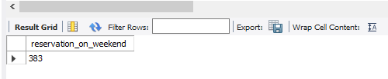
6. How many reservations fall on a weekend (no_of_weekend_nights > 0)?
SELECT COUNT(no_of_weekend_nights) AS reservation_on_weekend FROM 2ndproject.`hotel reservation dataset` where no_of_weekend_nights>0;

Slide 9
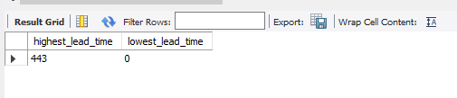
7. What is the highest and lowest lead time for reservations?
SELECT max(lead_time) AS highest_lead_time, min(lead_time) AS lowest_lead_time FROM 2ndproject.`hotel reservation dataset`;

Slide 10

8. What is the most common market segment type for reservations?
SELECT market_segment_type FROM 2ndproject.`hotel reservation dataset` GROUP BY market_segment_type ORDER BY market_segment_type DESC limit 1;

Slide 11
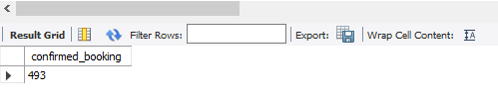
9. How many reservations have a booking status of "Confirmed"?
SELECT count(booking_status) AS confirmed_booking FROM 2ndproject.`hotel reservation dataset` where booking_status = 'Not_canceled';

Slide 12

10. What is the total number of adults and children across all reservations?
SELECT (sum(no_of_adults)+sum(no_of_children)) AS no_of_adults_and_children FROM 2ndproject.`hotel reservation dataset` ;

Slide 13

11. What is the average number of weekend nights for reservations involving children?
SELECT avg(no_of_weekend_nights) AS avg_weekend_and_childrenFROM 2ndproject.`hotel reservation dataset` where no_of_children>0;

Slide 14
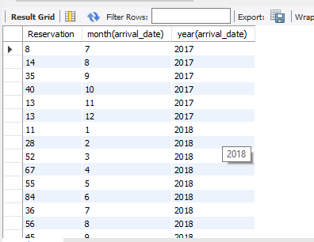
12. How many reservations were made in each month of the year?
SELECT count(Booking_ID) as Reservation, month(arrival_date), year(arrival_date) FROM 2ndproject.`hotel reservation dataset` GROUP BY year(arrival_date),month(arrival_date) ORDER BY year(arrival_date);

Slide 15
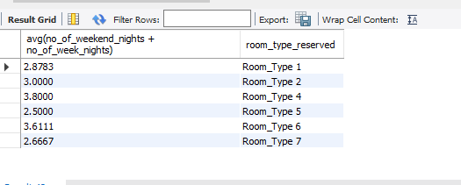
13. What is the average number of nights (both weekend and weekday) spent by guests for each room type?
SELECT AVG(no_of_weekend_nights + no_of_week_nights), room_type_reserved FROM 2ndproject.`hotel reservation dataset` GROUP BY room_type_reserved ORDER BY room_type_reserved;

Slide 16
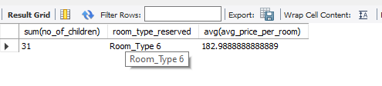
14. For reservations involving children, what is the most common room type, and what is the average price for that room type?
SELECT sum(no_of_children), room_type_reserved, avg(avg_price_per_room) FROM 2ndproject.`hotel reservation dataset` GROUP BY room_type_reserved ORDER BY sum(no_of_children) desc limit 1;

Slide 17

15. Find the market segment type that generates the highest average price per room.
SELECT market_segment_type, AVG(avg_price_per_room) AS highest_avg_price FROM 2ndproject.`hotel reservation dataset` GROUP BY market_segment_type ORDER BY AVG(avg_price_per_room) DESC limit 1;

Slide 18
Thank You

